Slide 1
Intermediate Python: Installing VS Code
Data Structures, Algorithms & Object-Oriented Programming

Slide 2
Installing VS Code
VS Code ships with Anaconda! Which should make it easy to install.
Since you had to install Anaconda in the pre-requisite course, we do not need to worry about installing Anaconda again.
If you have an older version of Anaconda, there are some extra steps – but I will guide you through them!

Slide 3
Opening Anaconda Navigator
First, open the Anaconda Navigator.
If you are on a Mac, you an search for it in using Spotlight.
If you are on a Windows machine, you can search for it in your start menu.
On the next screen, we will see a screen shot of the Anaconda Navigator.

Slide 4
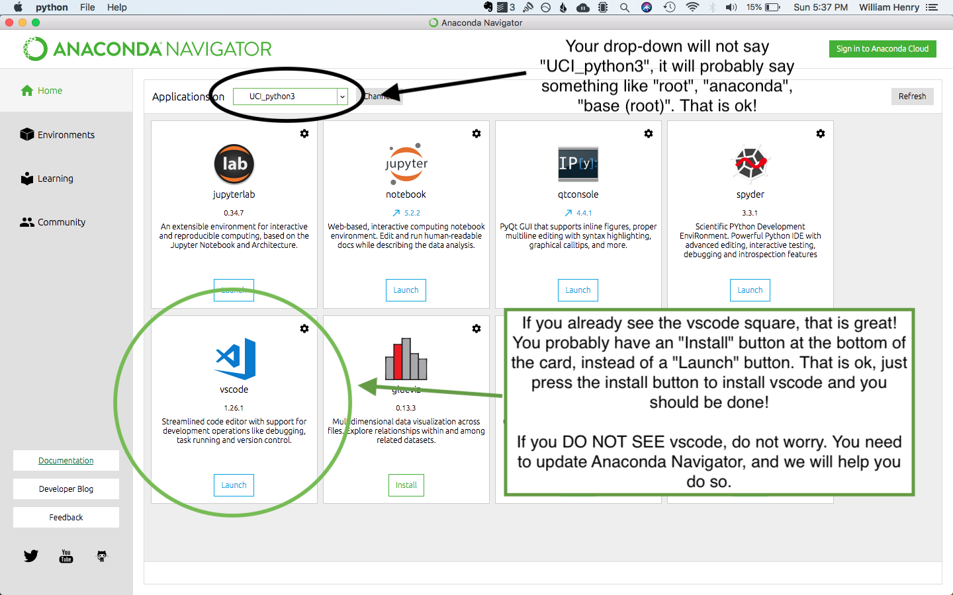
Opening Anaconda Navigator

Slide 5
Installing VS Code
If you already see the vscode “square”, just hit the Install button to install it. You can skip the next lecture on updating Anaconda Navigator.
If you DO NOT see the vscode “square”, please continue to the next lecture on updating the Anaconda Navigator

